Slide 1


Microprocessors and Assembly Language Spring 2020
Hamed Farbeh
farbeh@aut.ac.ir
Department of Computer Engineering
Amirkabir University of Technology
Lecture 23

Slide 2
Copyright Notice
Parts (text & figures) of this lecture are adopted from:
Arm Assembly Language Programming and Architecture, Volume 1, 1st edition, Muhammad Ali Mazidi, Sarmad Naimi, and Sepehr Naimi, MicroDigitalEd, 2013.
Microprocessors and Assembly Language, Spring 2020, AUT, Tehran, Iran

Slide 3
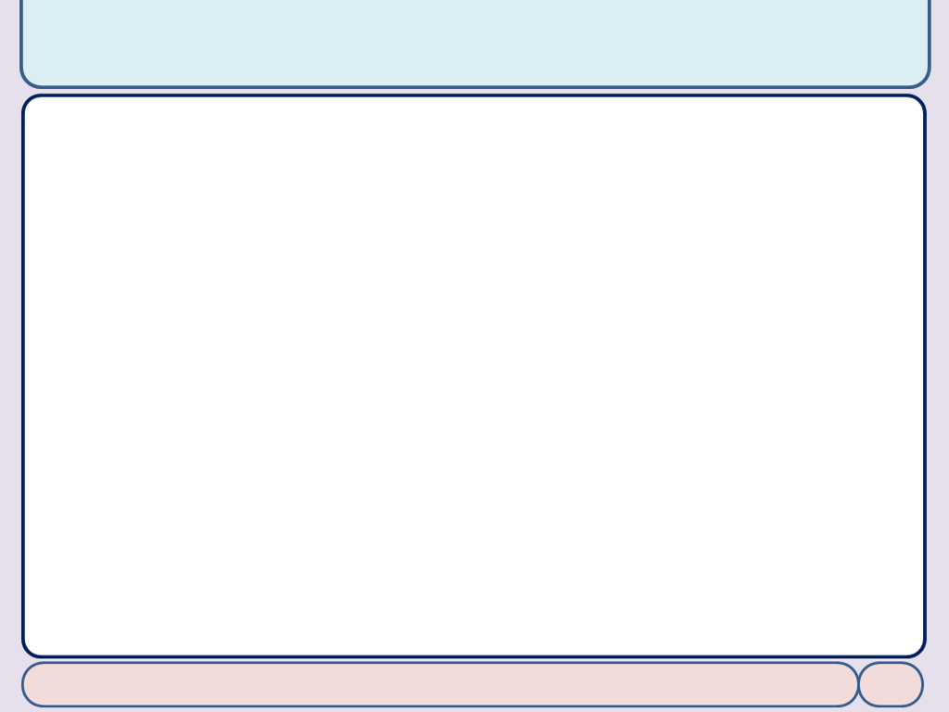
Stack and Stack Usage in ARM
Stack: A data structure that allows easy access to the top of the stack
Stack in assembly: A section of memory to store data temporarily
Hardware support to facilitate the creation and maintenance of stack
All the general registers can be used as a stack pointer
Descending stack: pointing to a lower address after push
Ascending stack: pointing to a higher address after push
Empty stack: point to where the new data will be stored
Full Stack: point to where the old data will be taken off
instructions PUSH, POP and interrupt handling assume the stack to be full descending
Microprocessors and Assembly Language, Spring 2020, AUT, Tehran, Iran

Slide 4
Stack and Stack Usage in ARM
Full descending stack
Stack pointer is pointing to the last word of data put onto the stack
If the stack is empty (no data stored in the stack yet)
SP is pointing to the word immediately below the stack
Initializing the stack pointer in ARM
The R13 (SP) register contains value 0 at power up
We must initialize the SP at the beginning of the program
Point to somewhere in the internal SRAM
Microprocessors and Assembly Language, Spring 2020, AUT, Tehran, Iran

Slide 5
Stack and Stack Usage in ARM
Stack_Top equ 0x40008000
AREA EXAMPLE_6_17, CODE, READONLY
LDR R13, =Stack_Top ; load SP
LDR R0, =0x125 ; R0 = 0x125
LDR R1, =0x144 ; R1 = 0x144
MOV R2, #0x56 ; R2 = 0x56
BL MY_SUB ; call a subroutine
ADD R3, R0, R1
ADD R3, R3, R2
HERE B HERE ; stay here
MY_SUB
; save R0, R1, and R2 on stack before use
SUB R13, R13, #4
STR R0, [R13] ; save R0 on stack
SUB R13, R13, #4
STR R1, [R13] ; save R1 on stack
SUB R13, R13, #4
STR R2, [R13] ; save R2 on stack
; -------- modify R0, R1, and R2
MOV R0, #15
MOV R1, #25
SUB R2, R0, R1
STR R2, [LR, #4]
; restore the original registers contents from stack
LDR R2, [R13] ; restore R2 from stack
ADD R13, R13, #4 ; R13 = R13 + 4 to increment the stack pointer
LDR R1, [R13] ; restore R1 from stack
ADD R13, R13, #4 ;
LDR R0, [R13] ; restore R0 from stack
ADD R13, R13, #4
BX LR ; return to caller
END
Microprocessors and Assembly Language, Spring 2020, AUT, Tehran, Iran

Slide 6
Stack and Stack Usage in ARM
STM and LDM
To store and load multiple registers with a single instruction
MY_SUB
; --------save R0, R1, and R2 on stack before they are used by a loop
STMFA R13, {R0-R2} ; save R0, R1, R2 on stack using Full Ascending
; --------R0, R1, and R2 are changed
MOV R0, #0 ; R0=0
MOV R1, #0 ; R1=0
MOV R2, #0 ; R2=0
; ---------restore the original registers contents from stack
LDMFA R13, {R0-R2}
; restore R0, R1, and R2 from stack using Full Ascending
BX LR ; return to caller
Microprocessors and Assembly Language, Spring 2020, AUT, Tehran, Iran

Slide 7
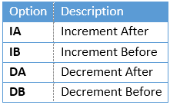
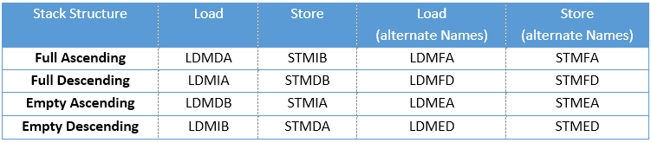
Stack and Stack Usage in ARM
Options for LDM and STM instructions
PUSH is an alias of “STMDB R13!”
POP is an alias of “LDMIA R13!”
Microprocessors and Assembly Language, Spring 2020, AUT, Tehran, Iran

Slide 8
Subroutine Call
Stack frame
A block of memory on the stack for a subroutine
Parameters are pushed onto the stack by the caller
The return address is pushed onto the stack from R14
Subroutine moves the stack pointer to leave a block of memory space for the local variables
The stack pointer is copied to another register to be used for access into the stack frame
Each subroutine should preserve any register it is going to use and restore them before return
Microprocessors and Assembly Language, Spring 2020, AUT, Tehran, Iran

Slide 9
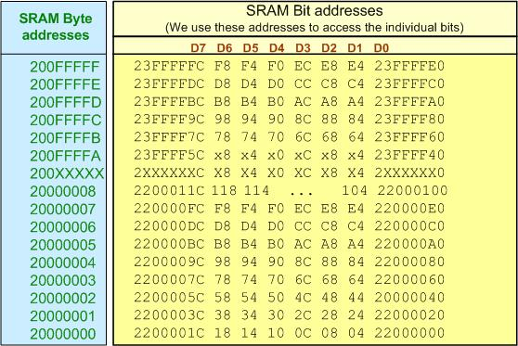
ARM Bit-Addressable Memory Region
Bit-banding option
Generally available in M3 and M4
To mitigate the issues of Read-Modify-Write
Only few small regions are bit-banded
Microprocessors and Assembly Language, Spring 2020, AUT, Tehran, Iran

Slide 10
ARM Bit-Addressable Memory Region
A program to set HIGH the D6 of the SRAM location 0x20000001
LDR R1, =0x20000001 ; load the address of the byte
LDRB R2, [R1] ; get the byte
ORR R2, R2, #2_01000000 ; make D6 bit high
; (binary representation in Keil for 0b01000000)
STRB R2, [R1] ; write it back
LDR R1, =0x22000038 ; load the alias address of the bit MOV R2, #1 ; R2 = 1 STR R2, [R1] ; Write one to D6
Microprocessors and Assembly Language, Spring 2020, AUT, Tehran, Iran

Slide 11
ADR, LDR, and PC Relative Addressing
Using PC (R15) register as the pointer register
LDR R0, [PC, #4]
What is the value of R0 if LDR is in address 0x00000004?
R0= 0x00000004 + 4 + 8
The ADR Pseudo-instruction
ADR Rn, Label ⬄ ADD Rn, PC, #offset
Implementing the LDR Pseudo-instruction
LDR R2, =0x12345678
Assembler stores the value as a constant in program memory
LDR R2, [PC, #0x0008]
Microprocessors and Assembly Language, Spring 2020, AUT, Tehran, Iran

Slide 12
End of Chapter 6!
Microprocessors and Assembly Language, Spring 2020, AUT, Tehran, Iran

